Slide 1
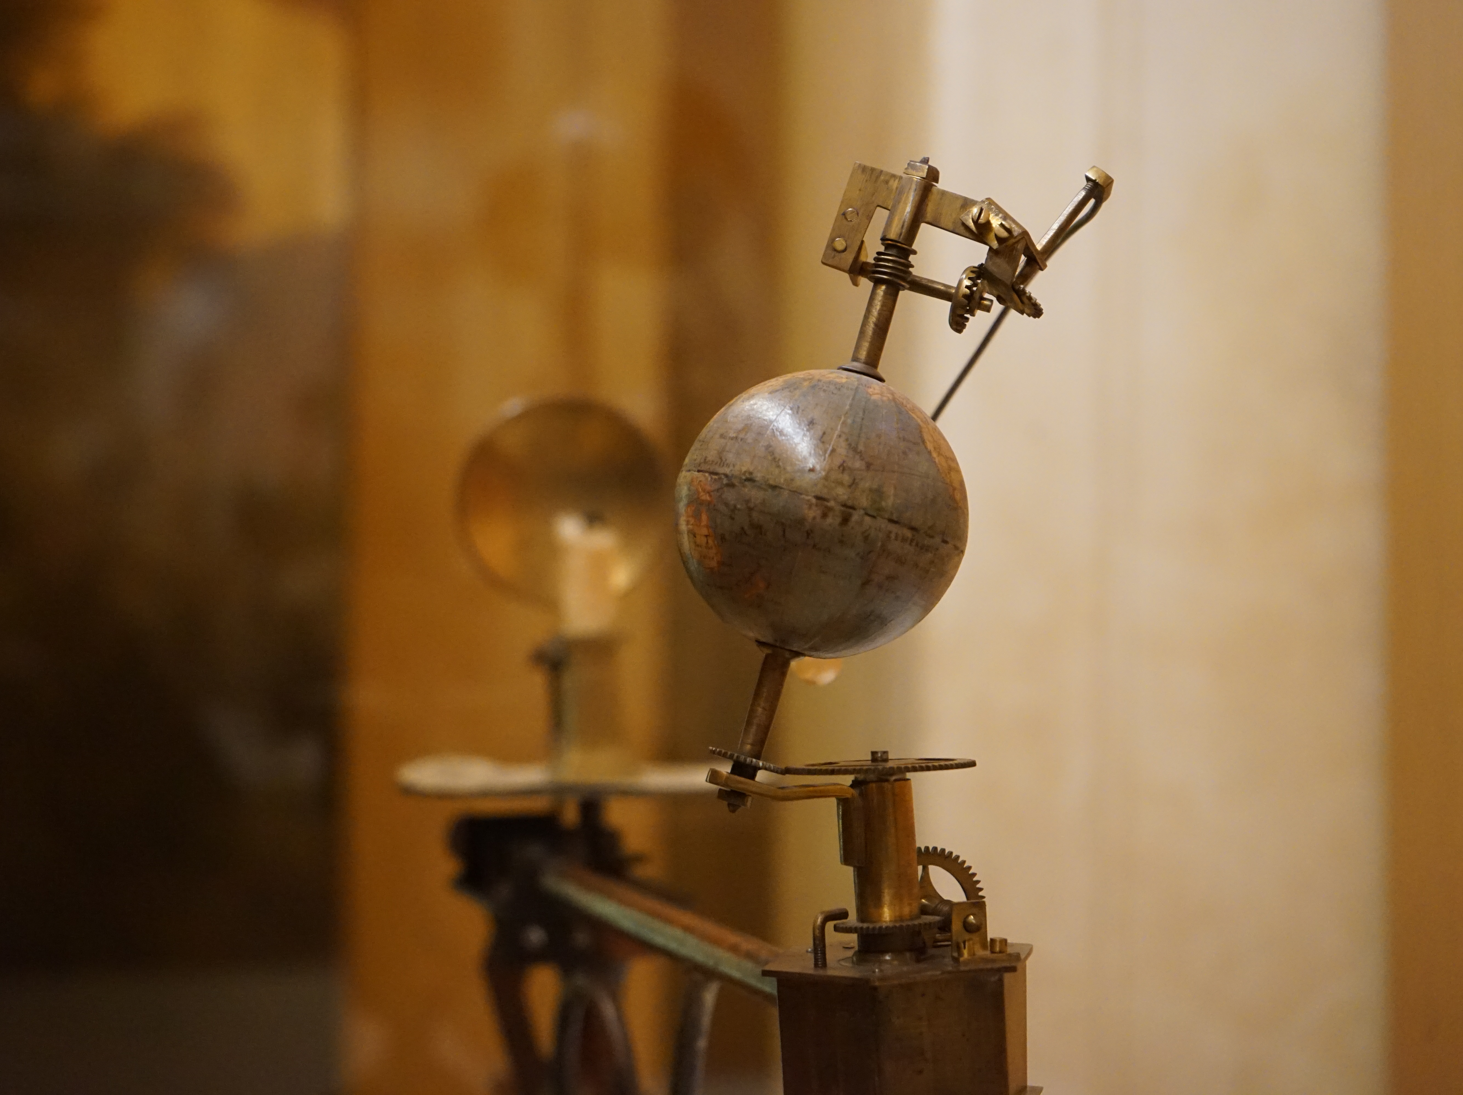
Astronomy 100/101 Lab 4
Wednesday 24 Mar / 31 Mar 2021 11.15am
Yvonne Ban: yiwenban@astro.umass.edu
Patrick Kamieneski: pkamieneski@astro.umass.edu
Yvonne Ban
Globenmuseum, Österreichische Nationalbibliothek
Vienna, Austria
21 Oct 2017

Slide 2
From last labs
If you’re behind on anything, let us know ASAP so we can help you catch up.

Slide 3
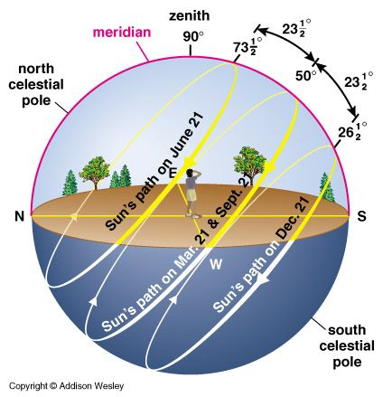
Altitude of the Sun
Remember how the Earth’s axis is tilted?
This means that the Sun doesn’t actually pass overhead for most of the world – not at noon or any other time!

Slide 4
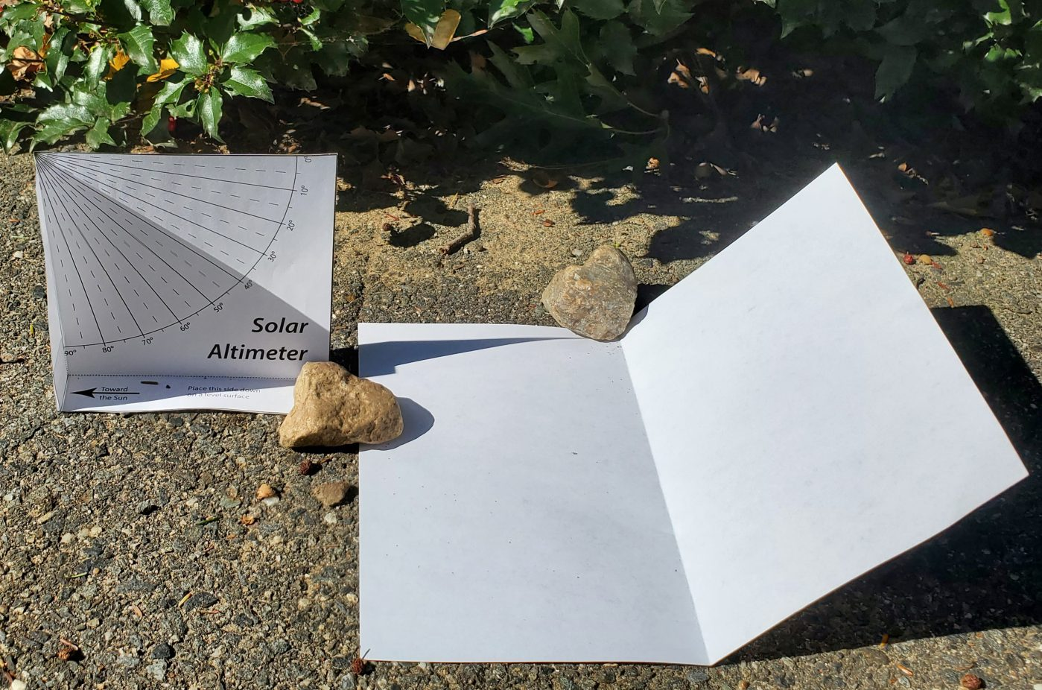
Instant altimeter – just add sun!
Download and print the solar altimeter from Moodle.
Try to use heavy paper if possible.
Cut out and fold according to instructions.
Try to make everything as square as possible.
Set up your altimeter outside
at noon (1pm for daylight savings)
at some time two hours from noon.
Orient your altimeter so the left flap casts a shadow across the altimeter.
Read off the Sun’s altitude.

Slide 5
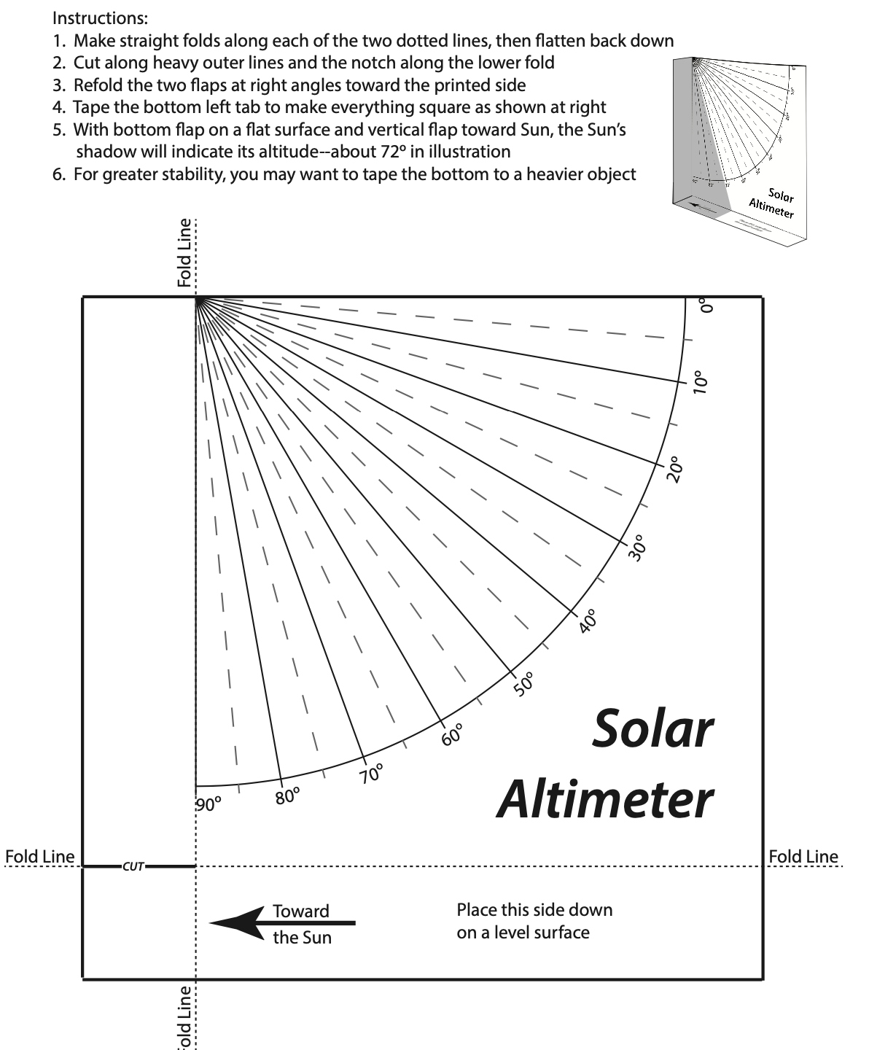
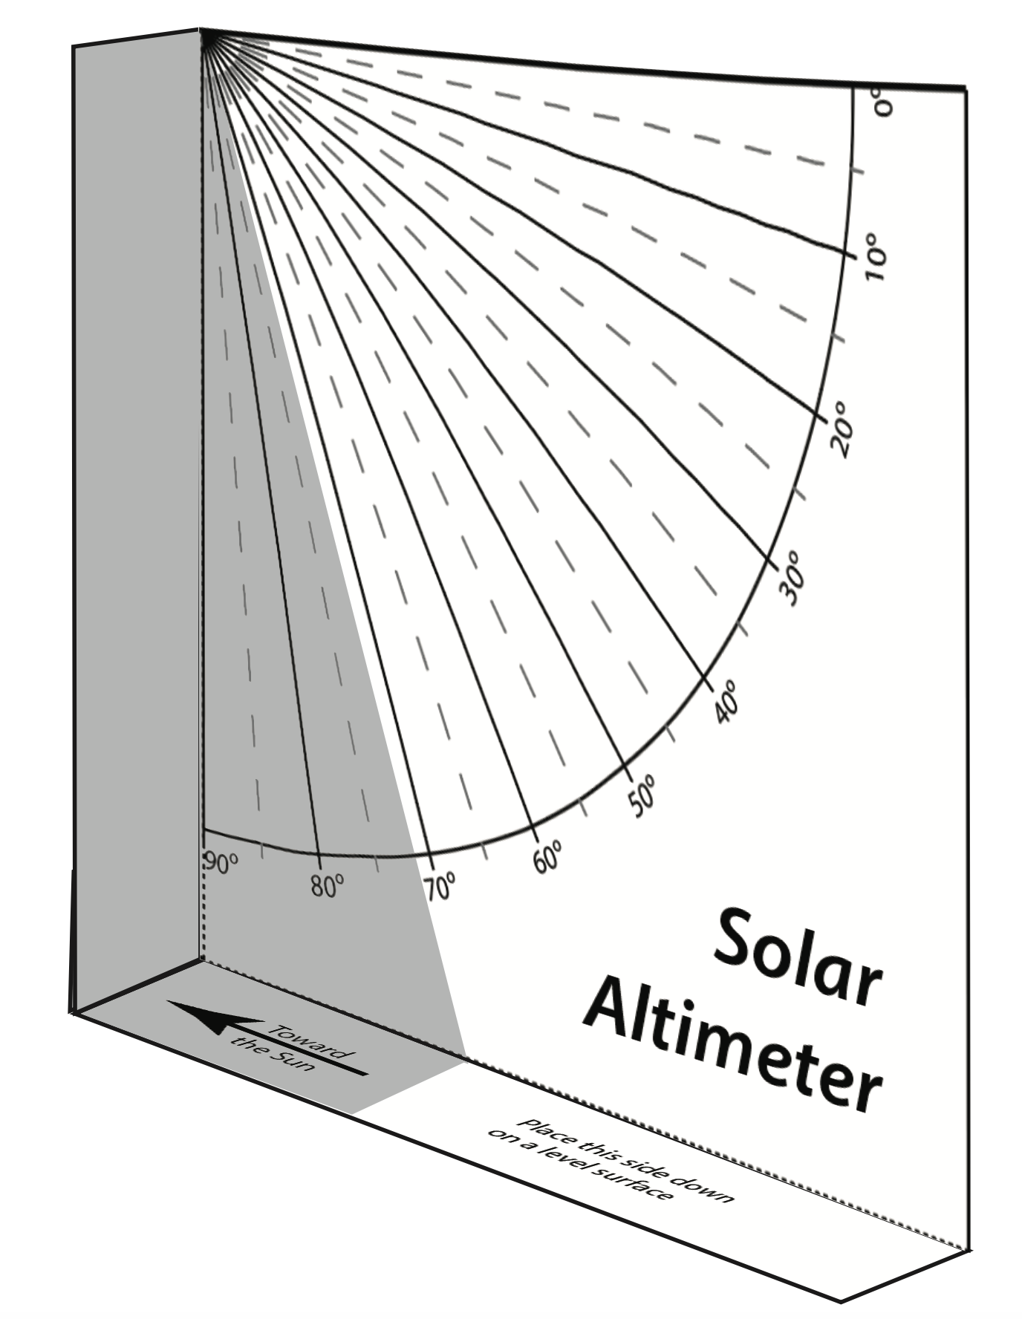
Download the PDF from Moodle
fold towards you
fold towards you

Slide 6
Instant photometer – just add sun!
Take a second piece of paper/card and crease it in the middle.
Put it on the ground so one side is flat.
Prop up the other side so it is directly facing the sun. Is one side brighter than the other?
Take a picture of your altimeter and photometer.

Slide 7
Instant altimeter – just add sun!
If you can’t print:
Use any piece of paper and fold it like the altimeter (straight flaps on bottom and side).
Mark the side of the shadow and measure it with a protractor.
Extra credit:
We’re giving extra credit for creative solutions to measuring the Sun’s altitude!

Slide 8

Instant altimeter – just add sun Stellarium!
Go into Stellarium. For the same date and time of your altimeter readings, note the azimuth and altitude of the Sun. Do they agree with what you found?

Slide 9
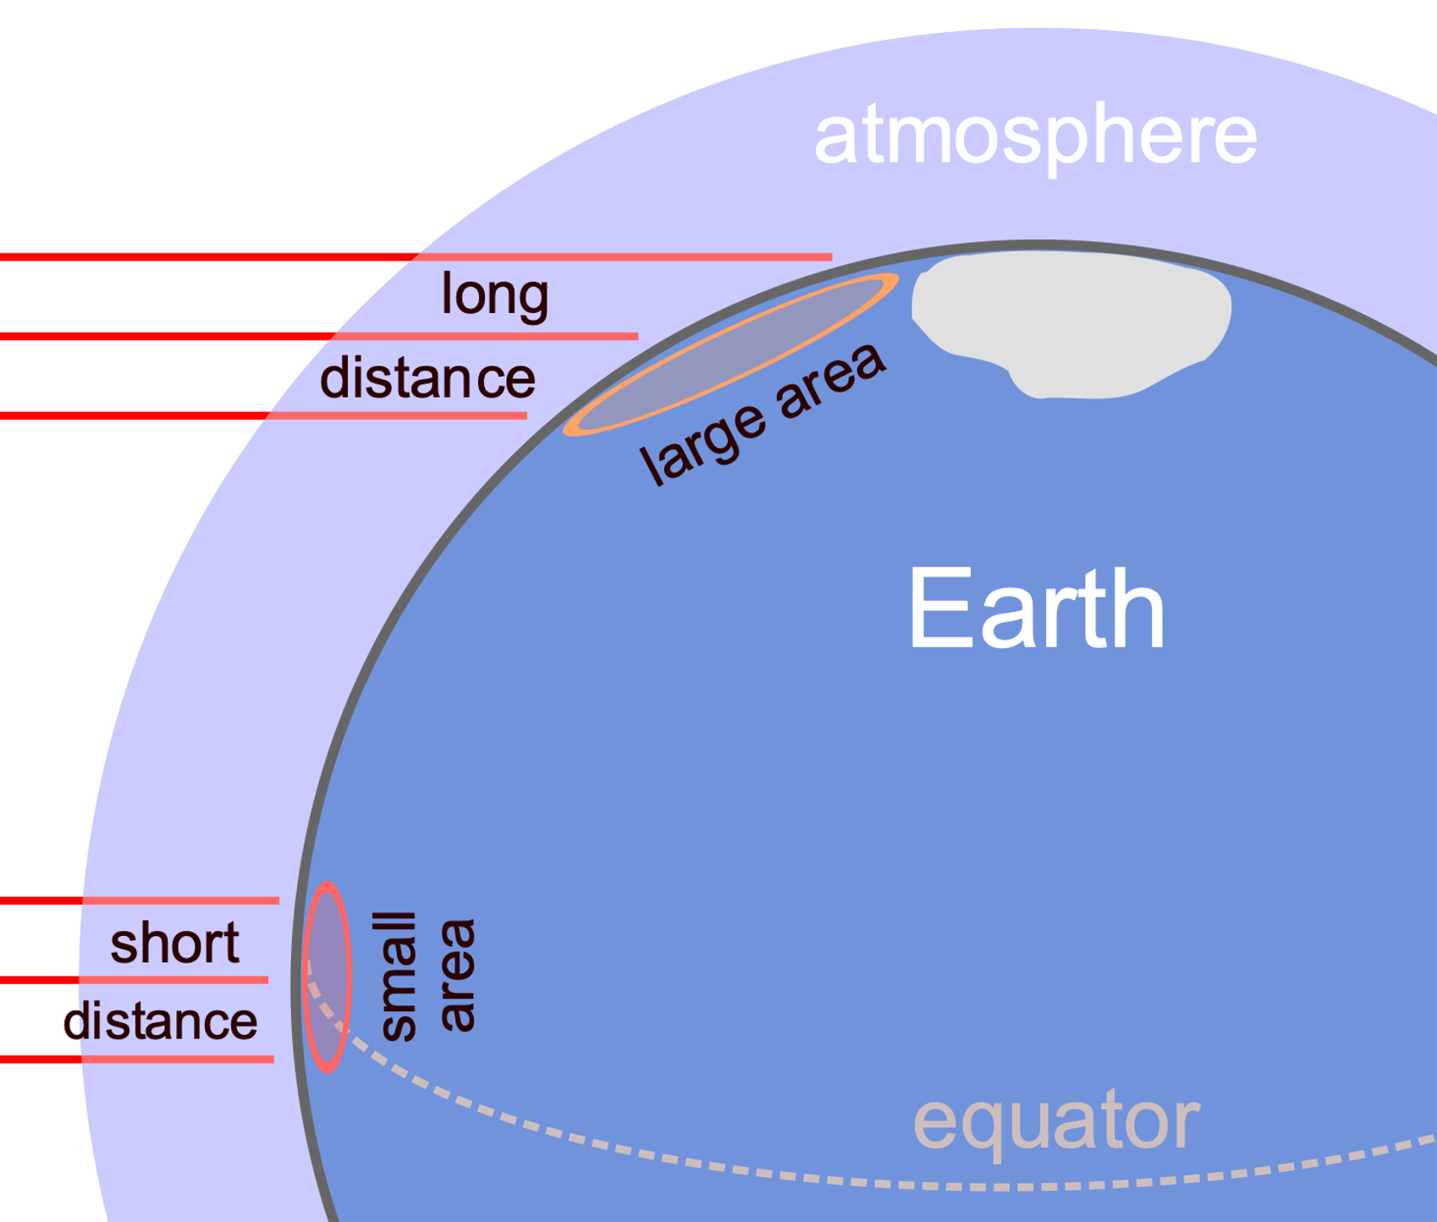
I need your love light
The angle the Sun shines at affects how much heat it provides.
This is proportional to sin(alt).
From https://simple.wikipedia.org/wiki/Sun_angle#/media/File:Oblique_rays_03_Pengo.svg under CC BY-SA 3.0

Slide 10
I need your love light
Calculate sine of the following values:
90 (This should be equal to 1. If it is not, make sure you are using degrees!)
Sun altitude at noon (beware daylight savings!)
Sun altitude at two hours from noon
In Stellarium, find out the Sun’s altitude at noon on
the summer solstice (21 Jun)
the winter solstice (21 Dec)
Calculate the sine of those two values.
Find the ratio between those two values.

Slide 11

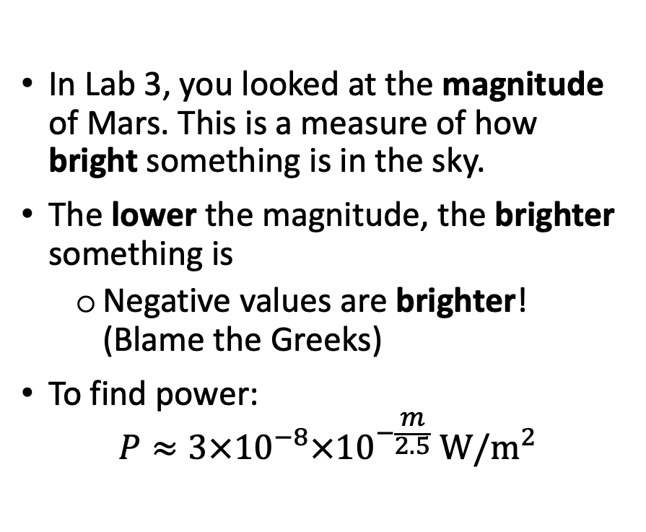
Near, far, wherever you are
In Lab 3, you looked at the magnitude of Mars. This is a measure of how bright something is in the sky.
The lower the magnitude, the brighter something is
Negative values are brighter! (Blame the Greeks)
To find power:
$$P≈3×{10}^{−8}×{10}^{−\frac{m}{2.5}} \text{W}\text{/}{\text{m}}^{2}$$

Slide 12

Near, far, wherever you are
Open Stellarium and select the Sun.
Open the Date and Time window in Stellarium.
Find the Sun’s
maximum
minimum
magnitudes over the next year (Oct 2020 to Oct 2021).
Find the corresponding power for those two values.
Find the ratio of the power.

Slide 13

Near, far, wherever you are
Open the Location window in Stellarium.
Choose Mars in the menu.
As before, open the Date and Time window and find the Sun’s
maximum
minimum
magnitudes over the next year.
Find the corresponding power for those two values.
Find the ratio of the power.
(The values are provided in the Lab 4 questions on Moodle.)

Slide 14
Near, far, wherever you are: Extra credit
Go to another planet and repeat the same steps.
You can choose from Jupiter, Saturn, Uranus, Neptune, Ceres, Pluto, Eris, Haumea, or Makemake. (Eris, Haumea, and Makemake have a numerical prefix starting with 136.)
Make sure you cover a full orbital period for the planet – this may be longer than an Earth year!
Write up your answers to the following questions:
Find the brightest and faintest magnitudes of the Sun and convert these to Watts/m².
Find the ratio of the Sun’s dimmest brightness there to the dimmest value on Earth, and convert that to an altitude (as you did for Mars).
What latitude on Earth would have the Sun at this altitude at noon on the winter solstice?
Submit your write-up on Moodle.

Slide 15
Assignment Summary
Make a solar altimeter and photometer.
Measure the Sun’s altitude and photometry at
noon (1pm in Daylight Savings Time)
two hours from noon.
Take a picture of each measurement.
Find the maximum and minimum magnitudes of the Sun
in a year from your location
in a year from Mars
Complete the Lab 4 questions on Moodle.
If you are using the web app and you want to do the planet extra credit, email us.
Due date: Wednesday 7 April 23:59

Slide 16
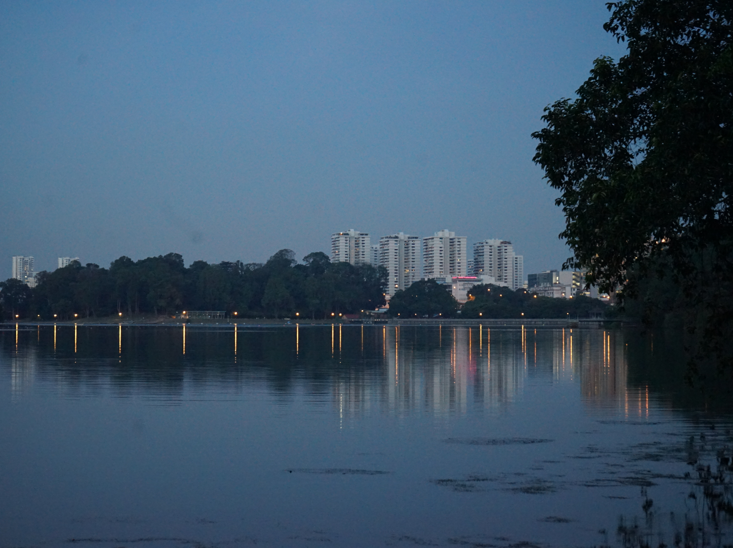
Yvonne Ban
MacRitchie Reservoir
Singapore
9 Aug 2016

